Slide 1
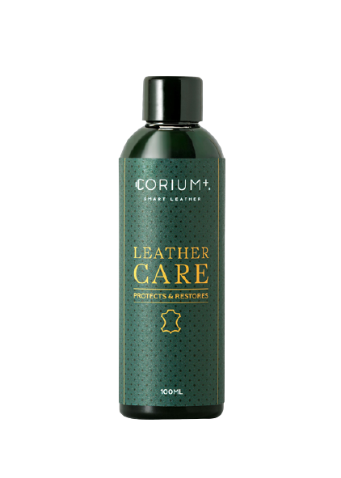
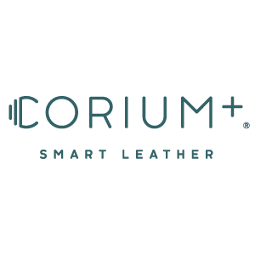
LEATHER
C A R E

Slide 2
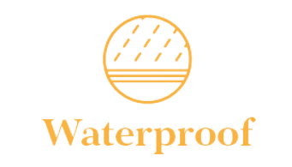
WHAT IS CORIUM+® SMART LEATHER?
Leather is the oldest material used by man valued for its comfort and protection
CORIUM+® SMART LEATHER adds functionality with the latest processing and lamination technology to offer the ultimate smart leather solution for year-round use.
CORIUM+® SMART LEATHER
garments are fully seam sealed and constructed to be
100% waterproof.
CORIUM+® SMART LEATHER is 100% windproof, preventing the wearer from wind chill thanks to its laminated membrane structure.
CORIUM+® SMART LEATHER is engineered to allow water vapour to pass from the inside to the outside of the garment but at the same time prevent rain entering from the outside.

Slide 3
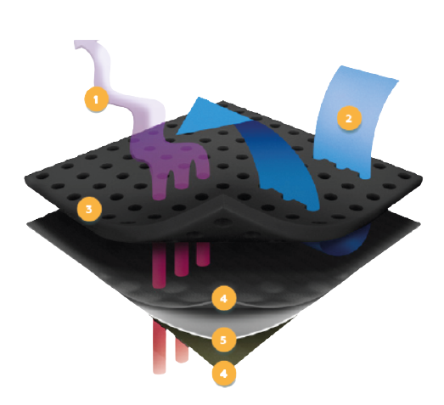
Dynamic Comfort Performance
CORIUM+® SMART LEATHER responds to the changing comfort needs with a waterproof breathable textile laminate
Perspiration and sweat are transported outside the garment
100% durably waterproof to withstand the most extreme weather
Functionalised leather allows breathability, minimized water pickup and wicking and other heightened functionalities.
· Minimal wicking (<1cm/h)
· Minimal water (<10%)
Reinforcement backing layers provides enhanced comfort and protects the membrane
Waterproof breathable PU membrane

Slide 4
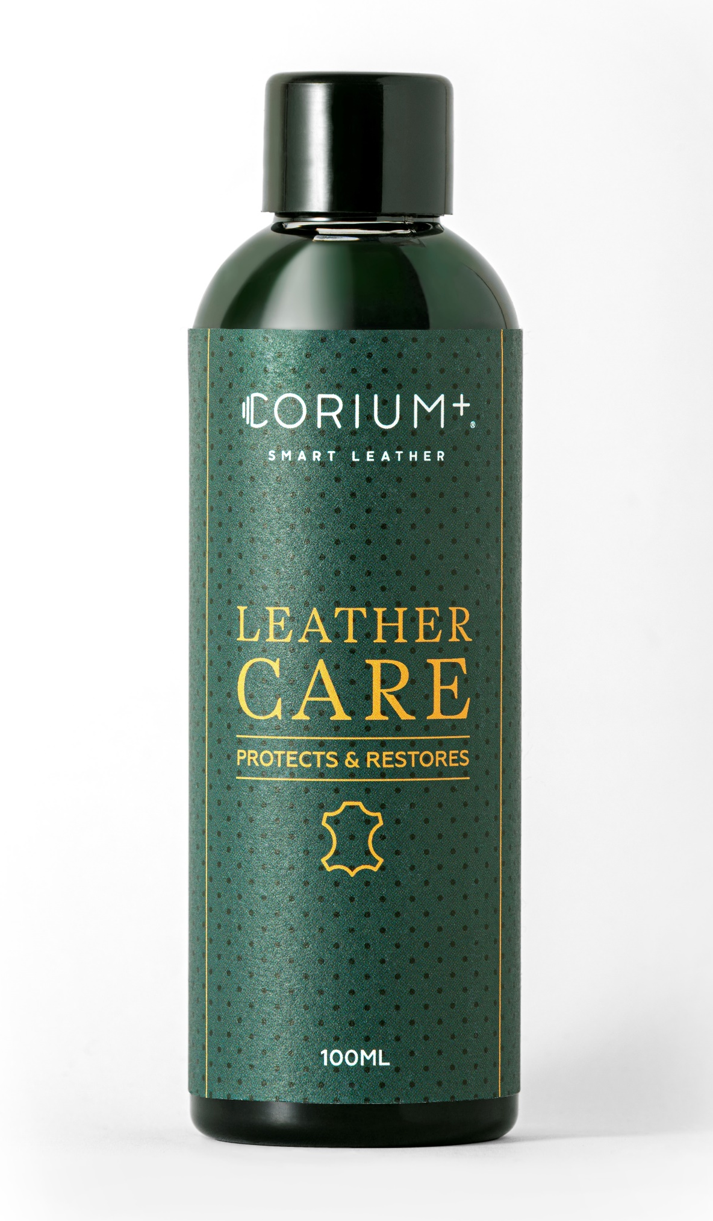
HOW TO CARE CORIUM+® SMART LEATHER?
Leather is a totally natural material that may experience a visual weathering and natural ageing specifically if there is prolonged exposure to direct sunlight.
So it’s essential to give your CORIUM+® SMART LEATHER garment
the attention and care it deserves.
LEATHER
C A R E
Keeps the leather hydrated
Retains its suppleness
Mantains the original colour

Slide 5
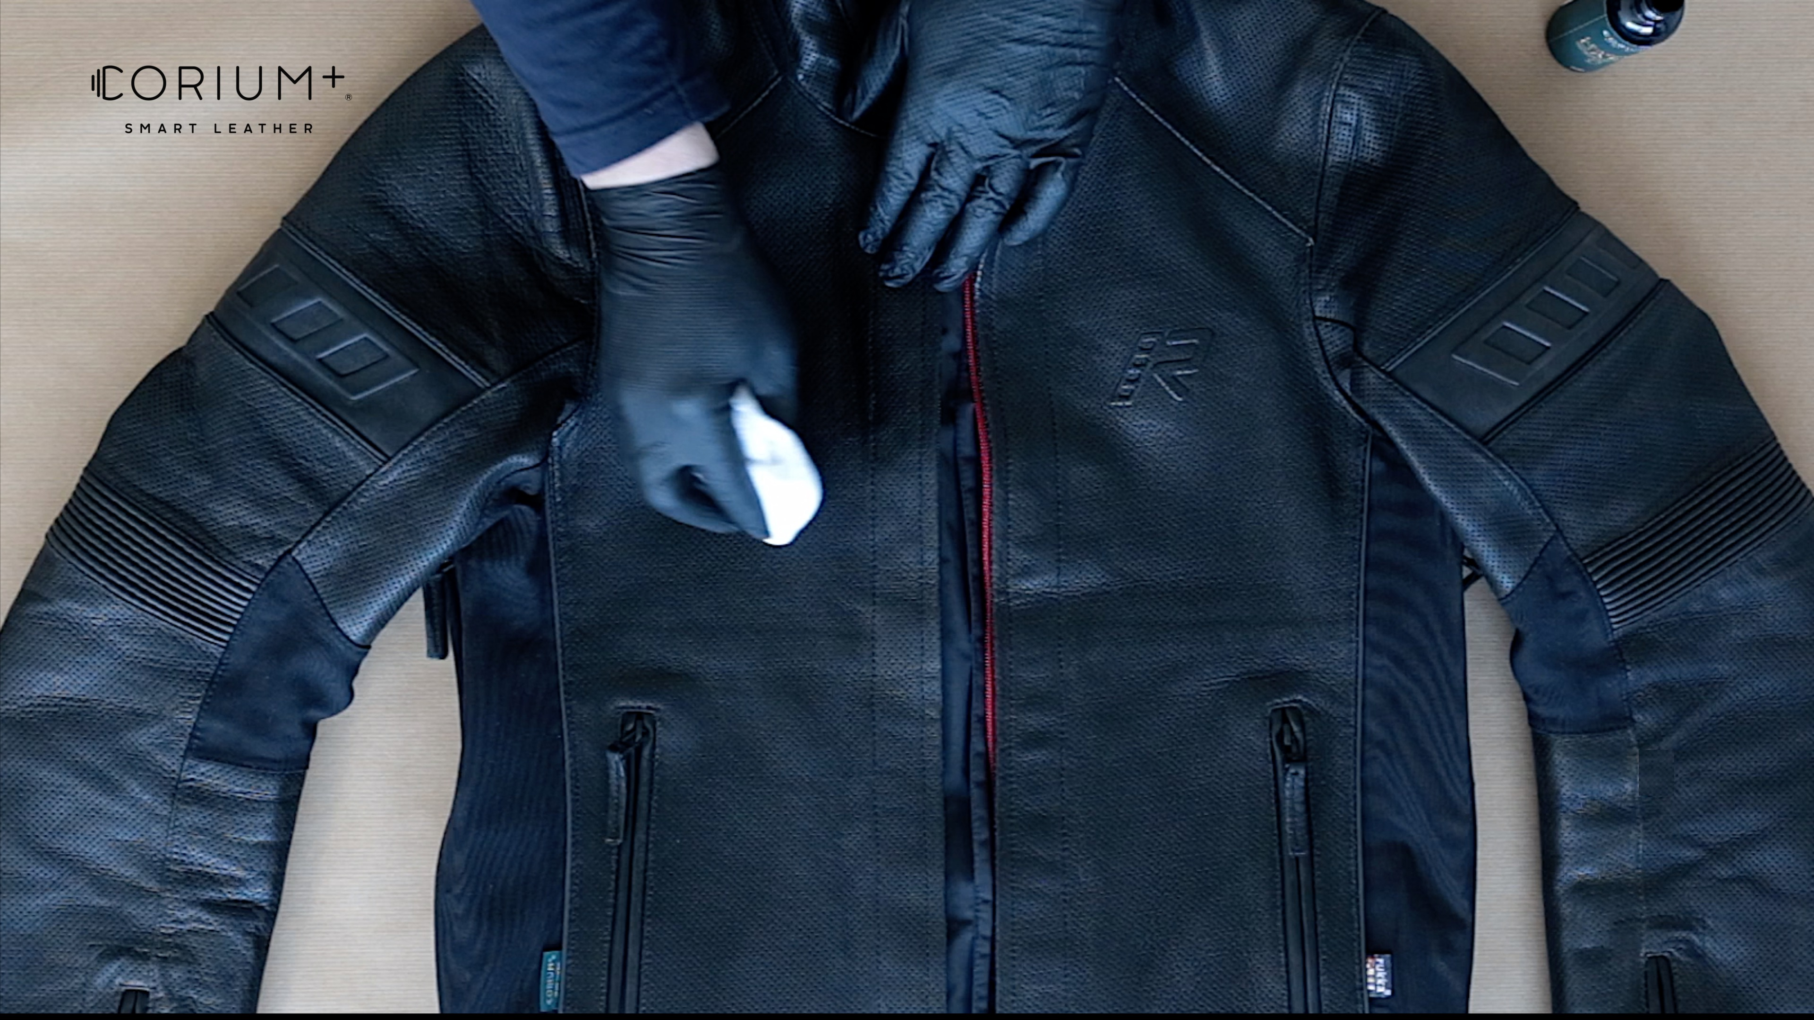
HOW TO APPLY CORIUM+® LEATHER CARE?
Put a paper or a plastic or you can ever use a newspaper on your worksurface to keep it clean.
We recommend to use disposable gloves to keep your hands clean.
Apply a small amount of the product to your lint free cloth.
Apply in a gentle circular motion to your CORIUM+® garment.
Take care not to apply the product to the seam labels or textile areas of the garment.
You can reapply the product as required depending on the frequency of application or the degree of weathering of your garment.
For best results we recommend to leave 4 hours between application.

